Slide 1

Romanian BookLink
by Natanael Apreutesei
Notes:
One thing that I learned during the year was that the best thing you can do before starting a project is to not start it. Well, let me explain. The best thing that you can do is starting by planning. Developers are lazy and if there is something out there to make their life easier, they will use it. That why in the beginning I stated by searching to see if there is a way to make my life easier. And so I stumbled onto Filament.

Slide 2

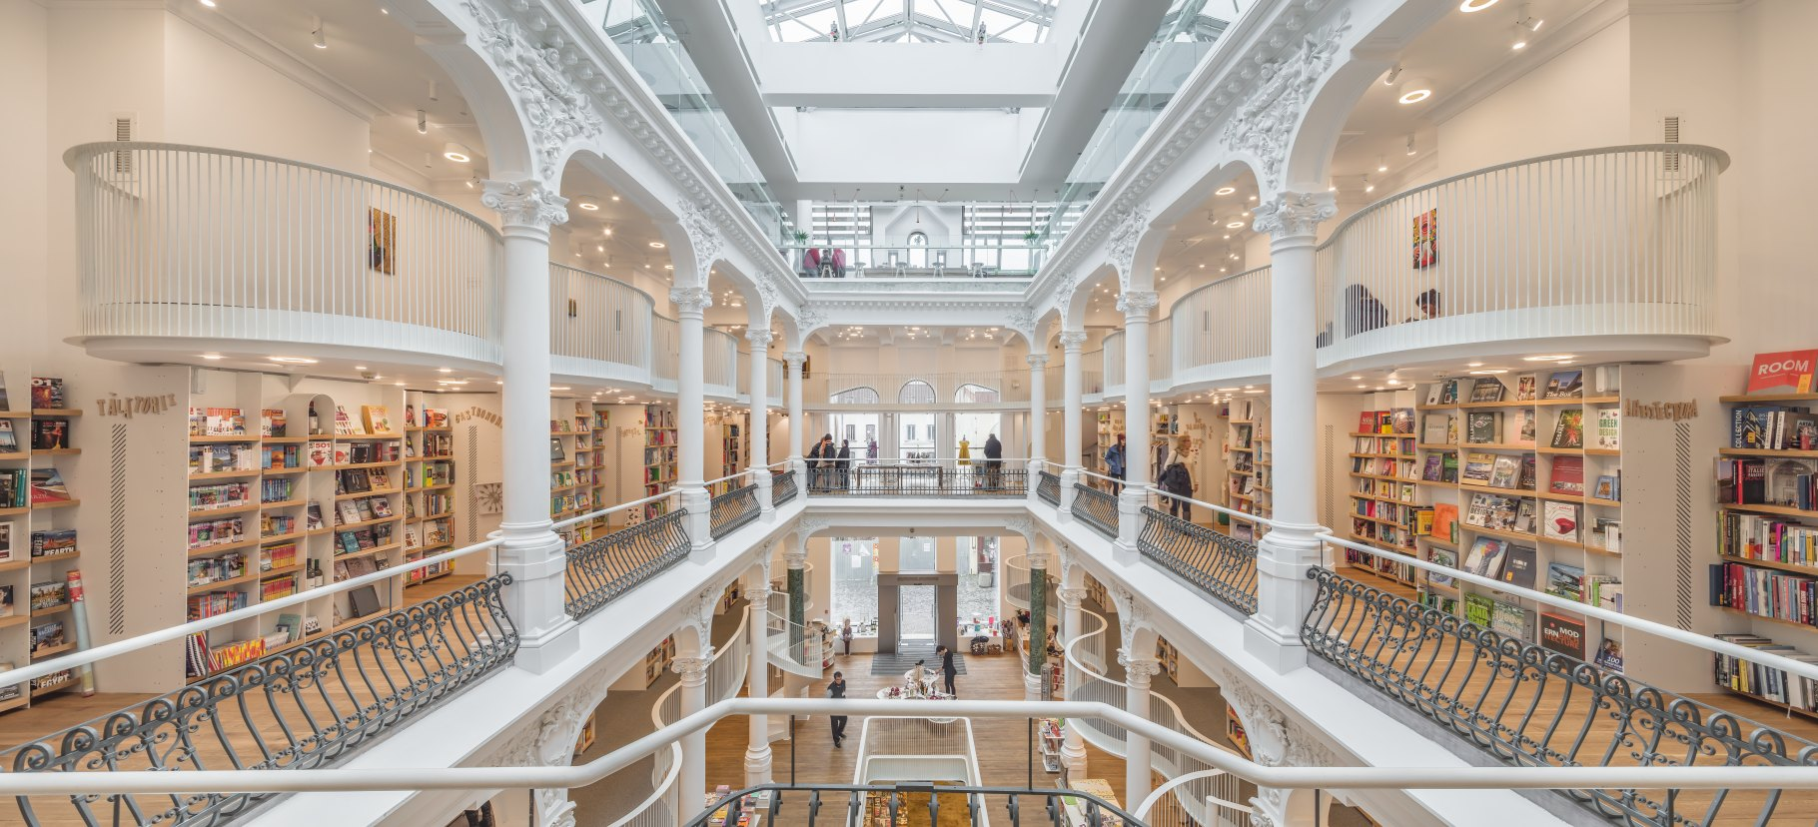
Project scope
To create an e-commerce site with the knowledge aquired during the year.
Personal goals
Test and Strengthen my skills
Publishable site
Learn new packages while building the site

Slide 3
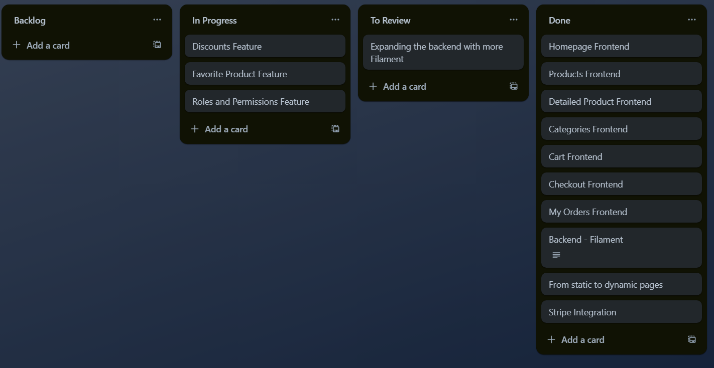
Kanban
All the project planning was done using a kanban to plan what pages and functionalities needed to be added.

Slide 4
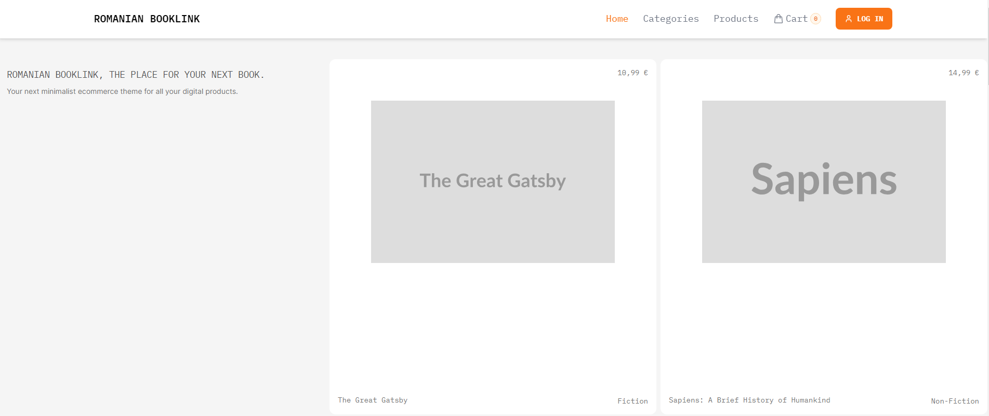
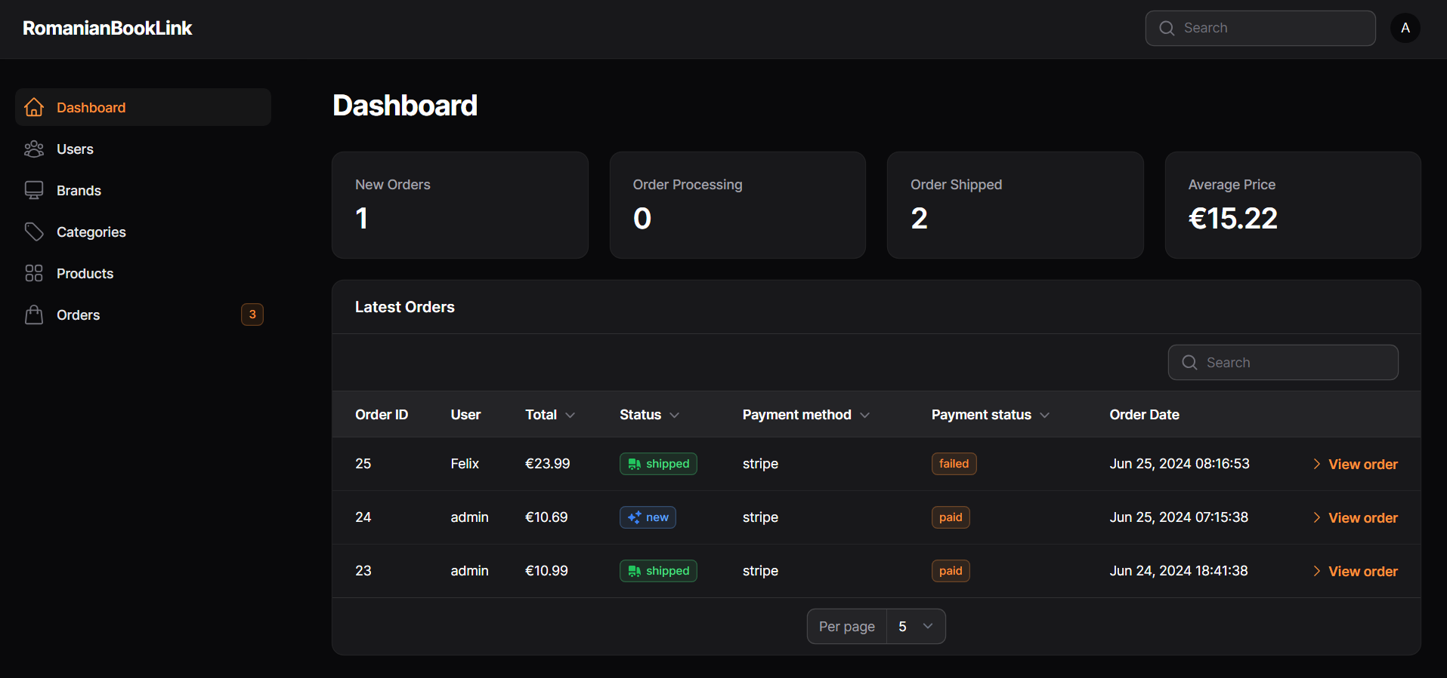
Layout and Pages
Frontend:
Homepage
Categories
Products
Detail Page Products
Cart and Checkout
My Orders
Orders Detail
User Profile
Backend:
Dashboard
Users
Brands
Categories
Products
Orders

Slide 5
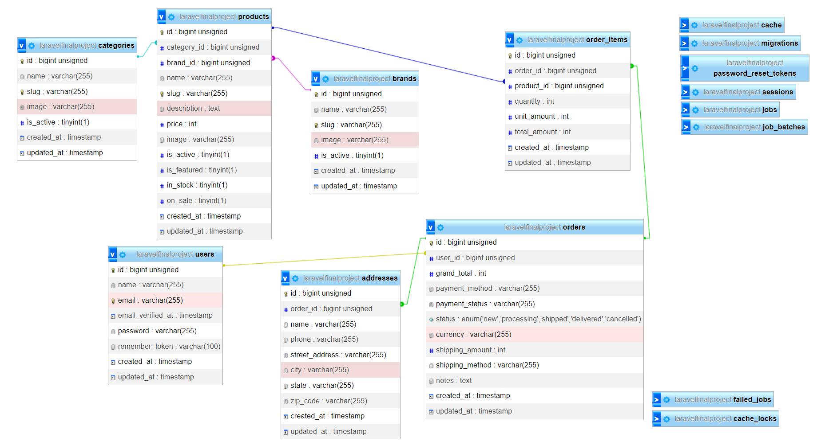
Database

Slide 6
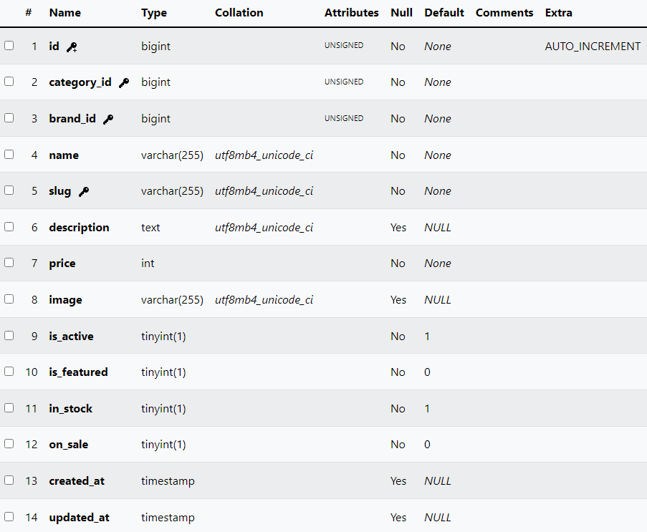
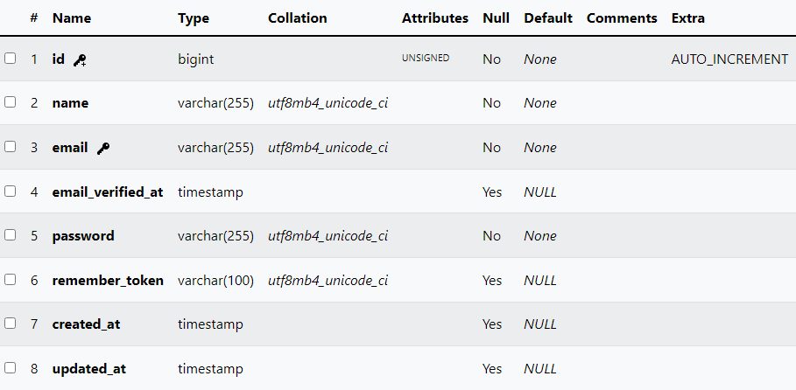
Database Tables
Products:
Users:

Slide 7
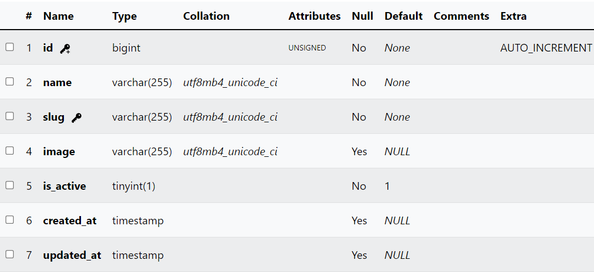
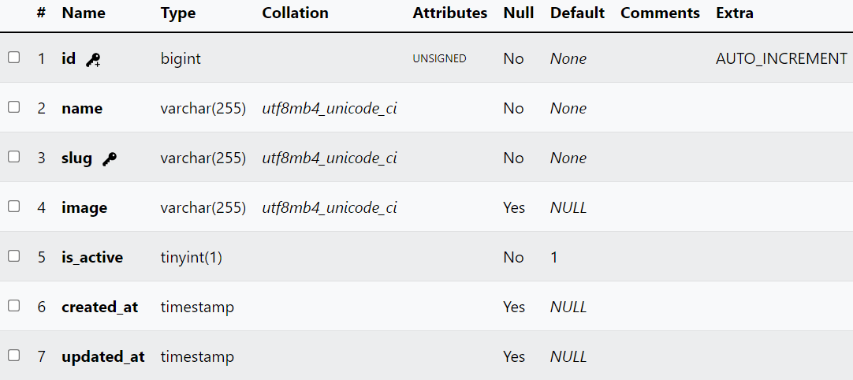
Database Tables
Users:
Products:

Slide 8
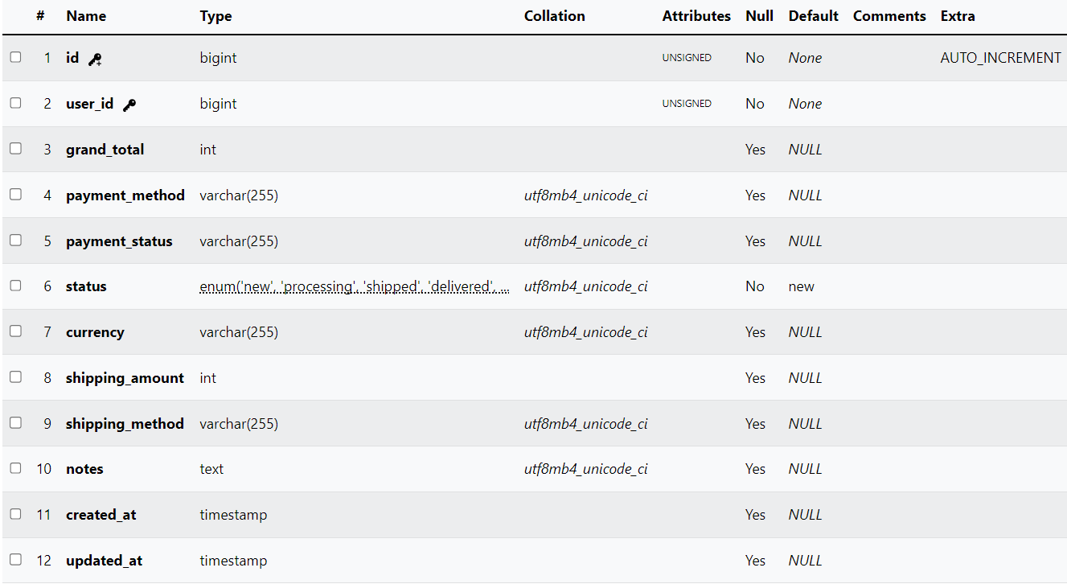
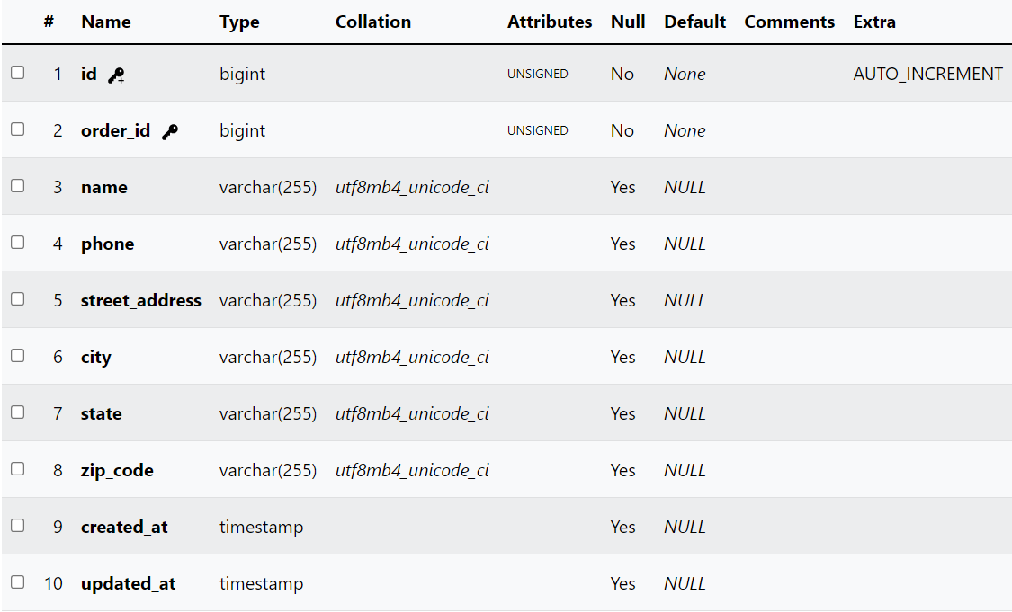
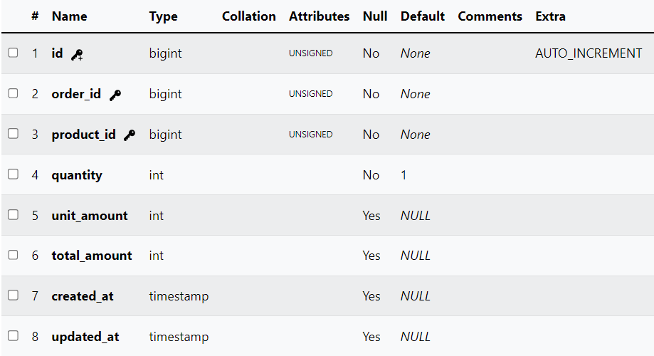
Database Tables
Orders:
Address:
Order Items:

Slide 9
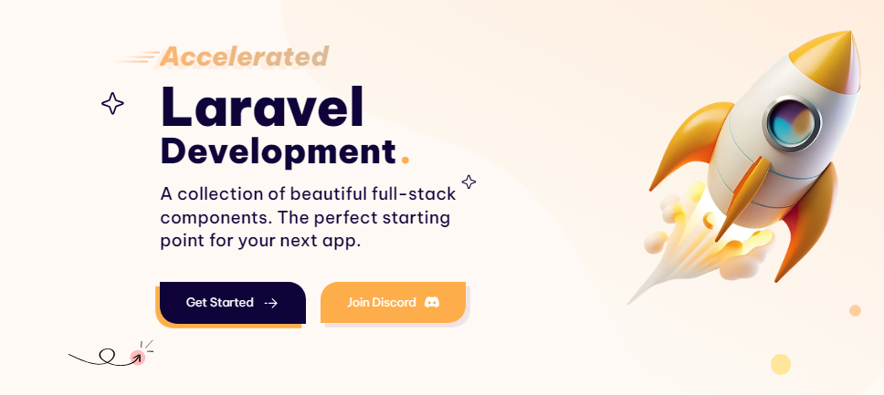
Backend
The backend was built with a new package called Filament. This is built on top of PHP and it allows you to build your backend much faster and flexibly then with basic PHP.
It works by providing a set of pre-built components that make it easy to create and manage admin panels, dashboards and forms for whatever Laravel application you are building.

Slide 10
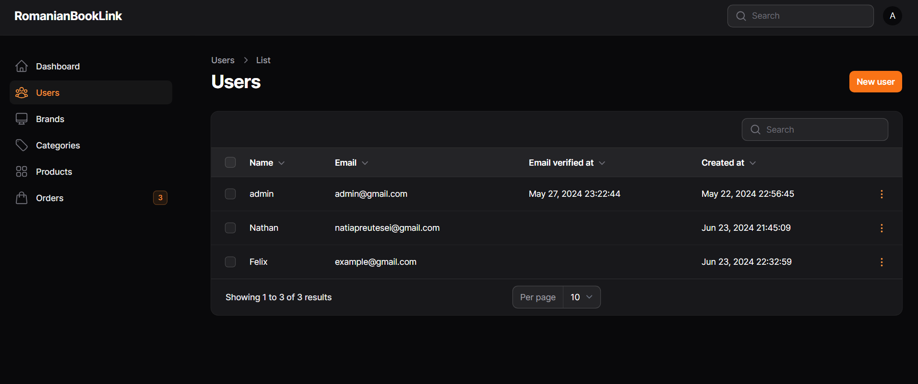
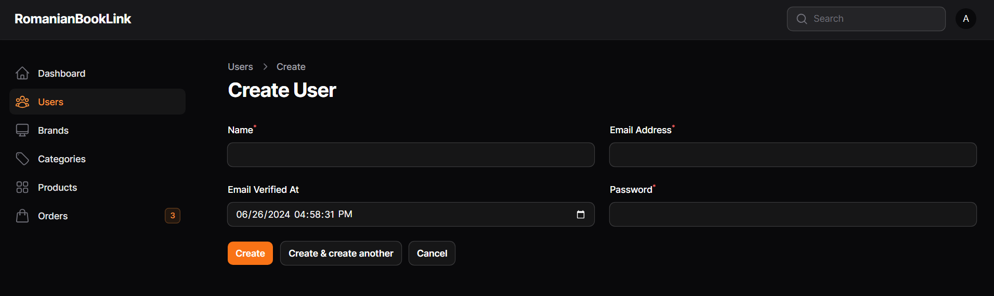
Backend Users

Slide 11
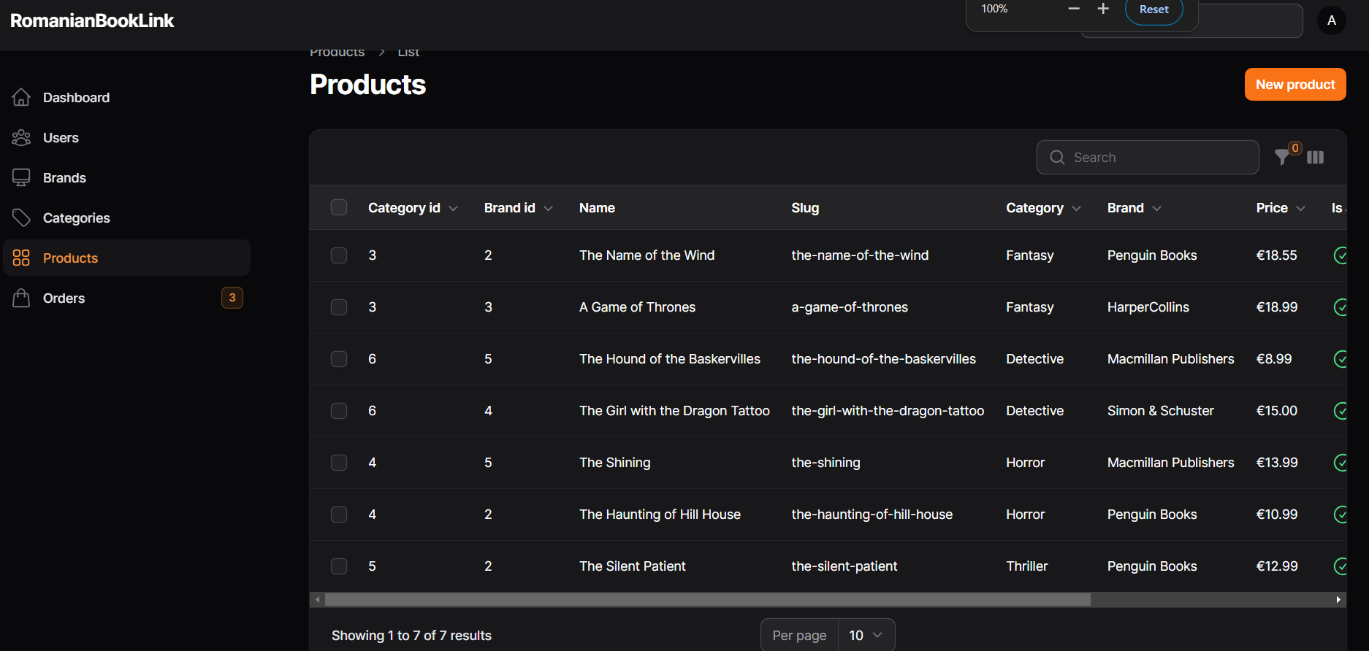
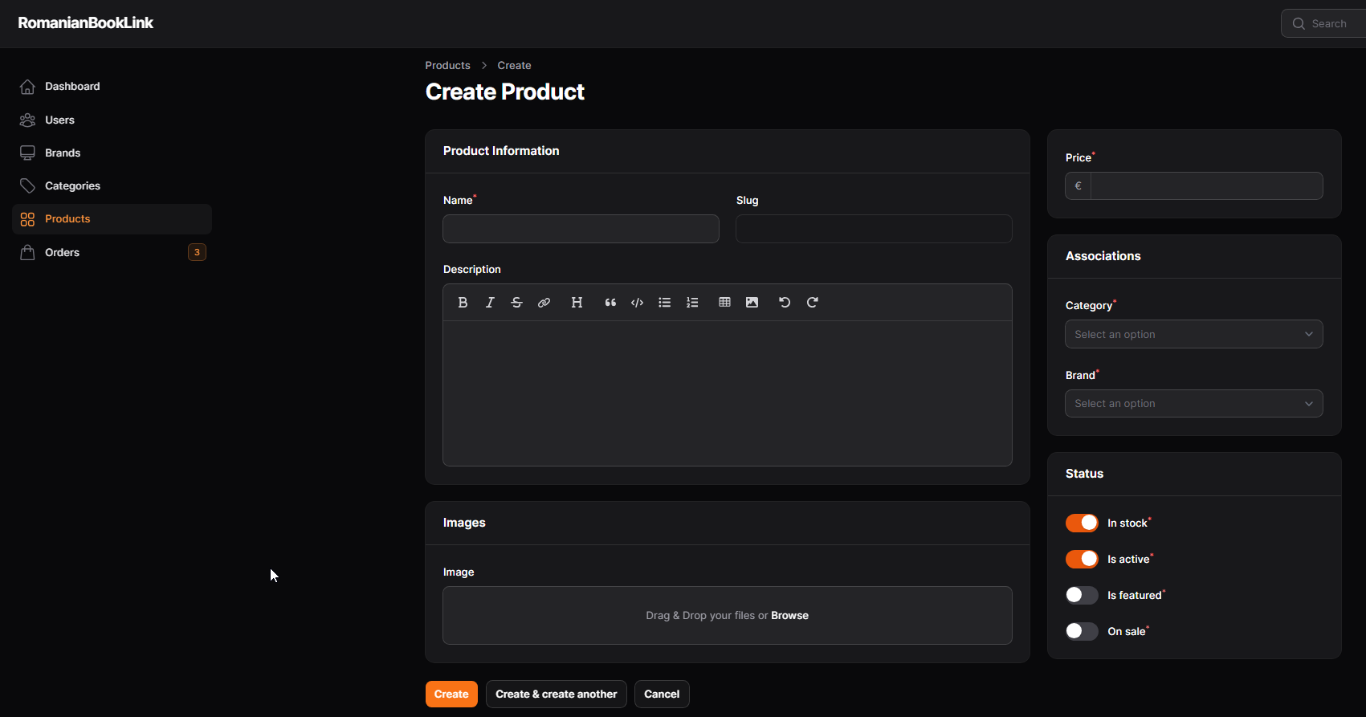
Backend Products

Slide 12
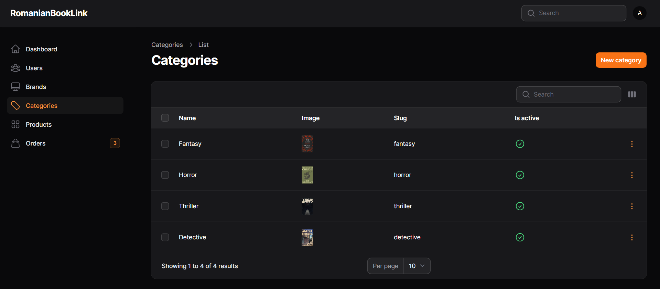
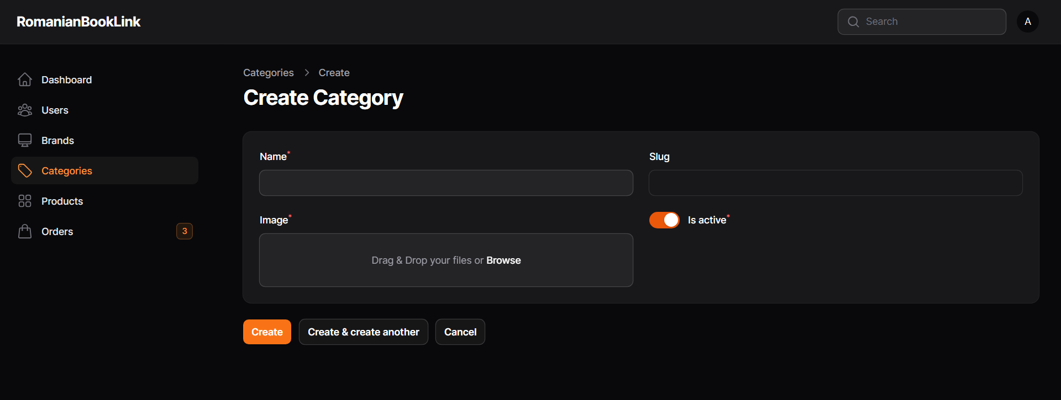
Backend Categories

Slide 13
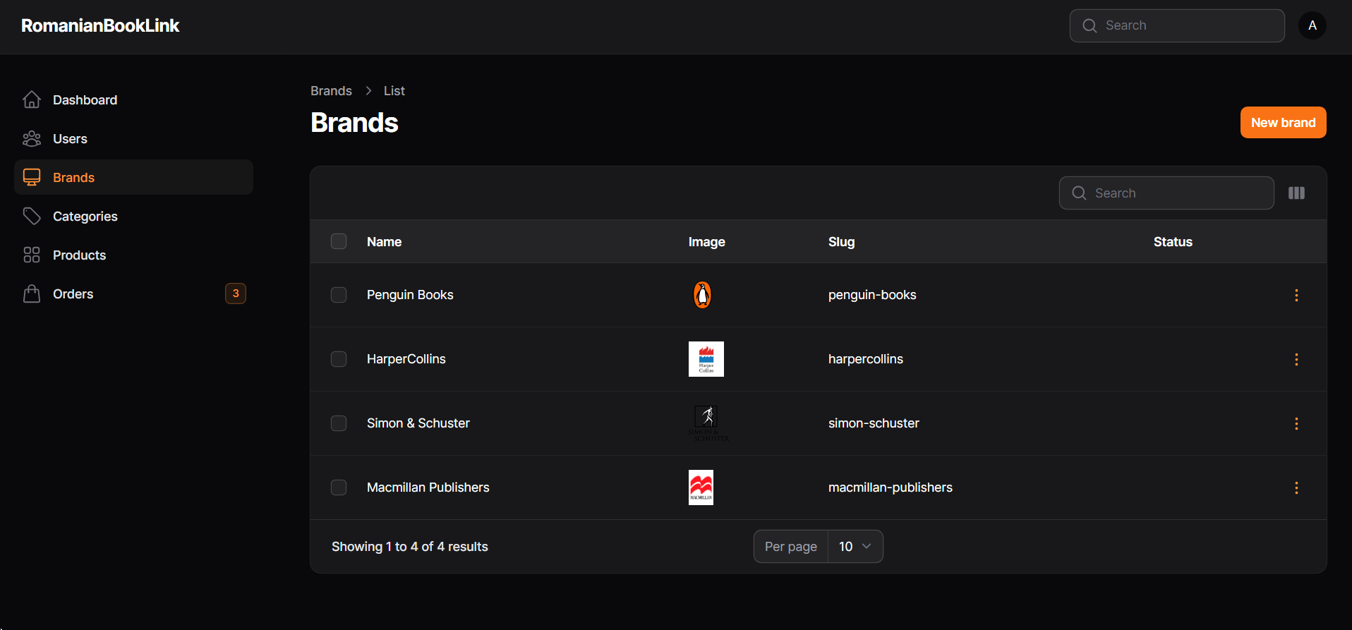
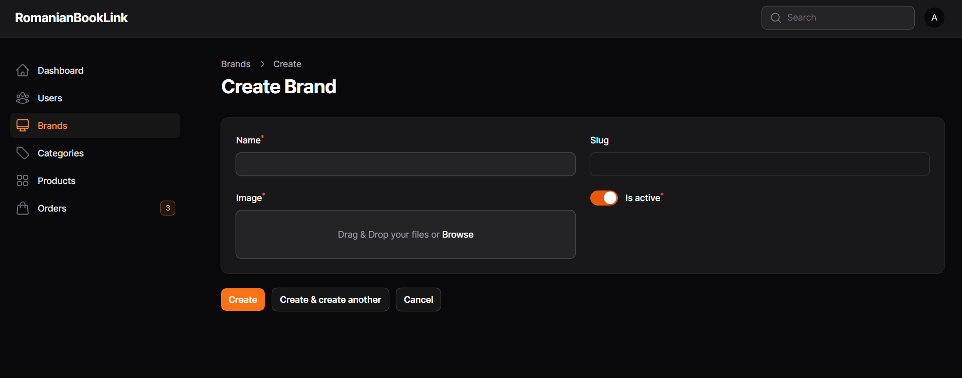
Backend Publishers

Slide 14
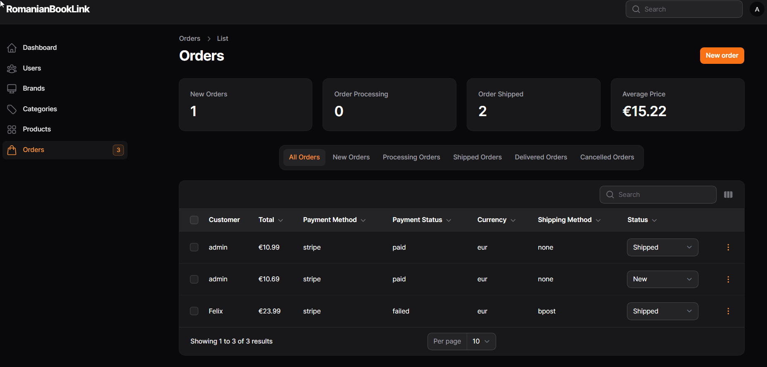
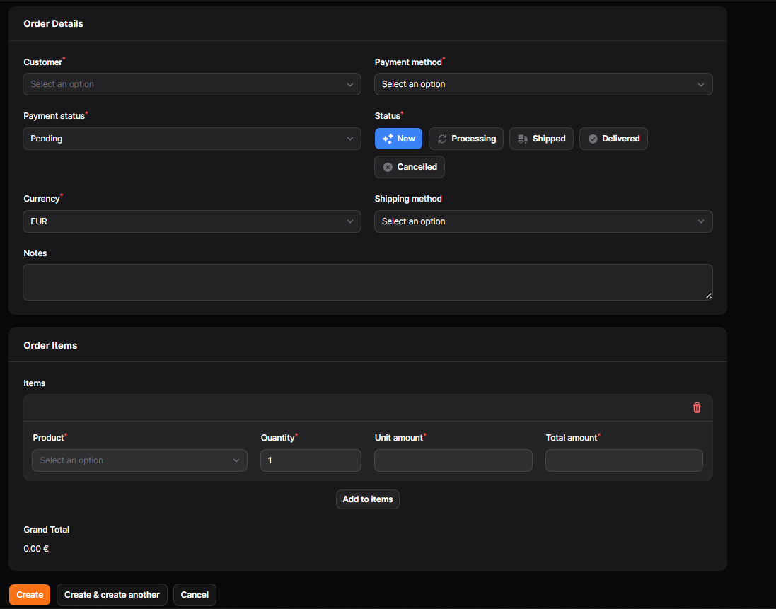
Backend Orders

Slide 15
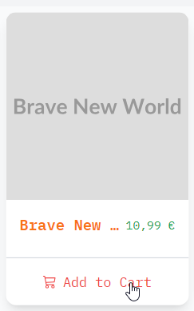
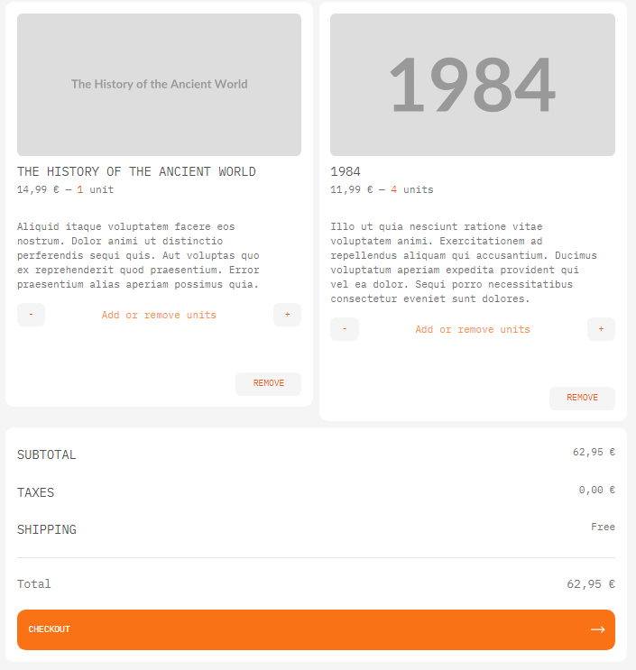
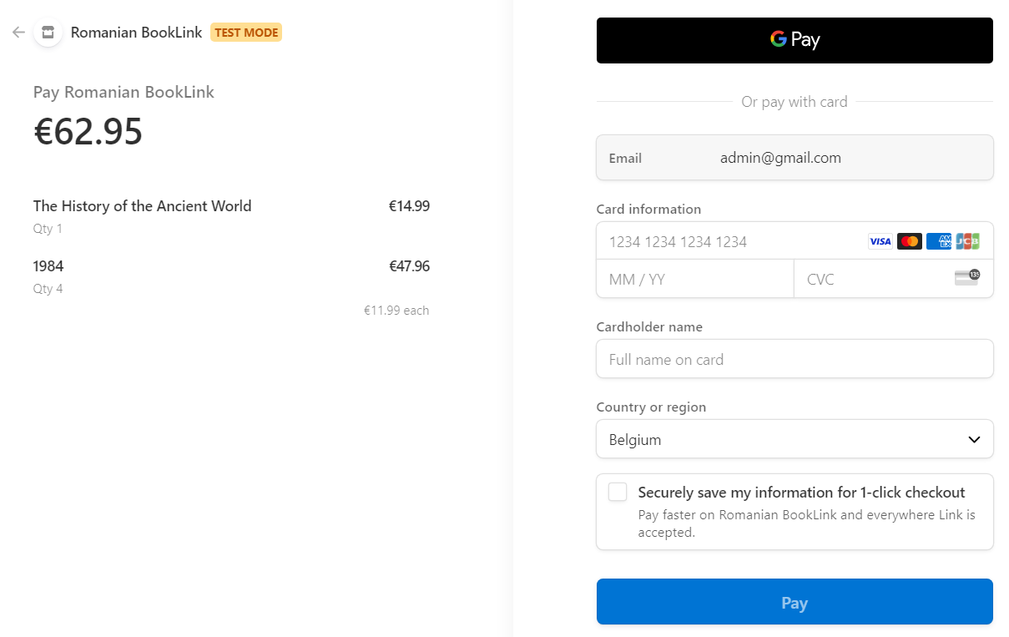
Checkout
The checkout process was done by integrating Stripe in the workflow.

Slide 16
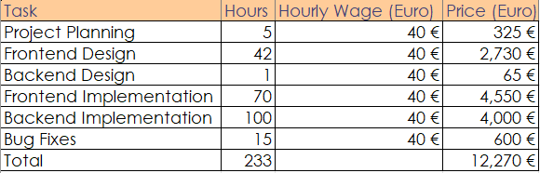
Cost Calculation

Slide 17

Bedankt voor uw aandacht

